Slide 1
FIFA World Cup Analysis - Unified mentor
Katuri Madhava Rajesh

Slide 2
Introduction:
The FIFA World Cup, the pinnacle of international football, is held every four years, drawing global attention. This analysis delves into historical data to uncover key metrics and factors influencing World Cup victories, aiming to provide insights and answer fans' questions

Slide 3
Details of data:
The analysis utilizes three datasets:
WorldCupMatches.csv : Contains detailed match information, including goals, attendance, and team names.
WorldCupPlayers.csv : Provides player-level data, including positions, events, and line-ups.
WorldCups.csv : Summarizes each World Cup's overall statistics, including goals scored, teams, matches played, and attendance.

Slide 4
Main KPI’s:
Total Goals Scored : The cumulative goals scored in each World Cup.
Average Attendance : The average number of spectators per match.
Winning Factors : Goals scored by winning teams and performance trends.
Goals by Year : Trends in goals scored over the years.
Top Teams' Performance : Goals scored by top teams.

Slide 5
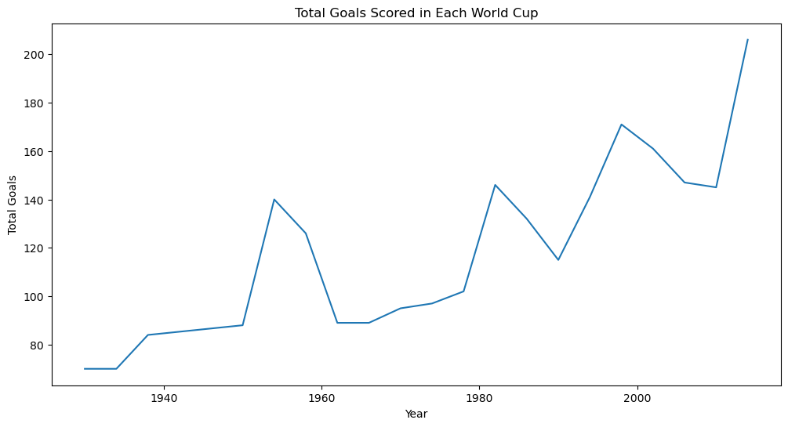
Total Goals Scored in Each World Cup:

Slide 6
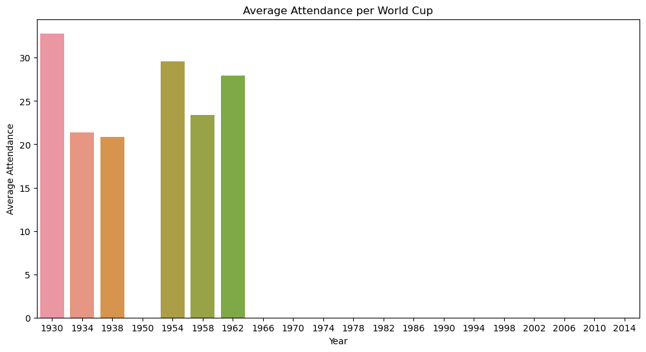
Average Attendance per World Cup:

Slide 7
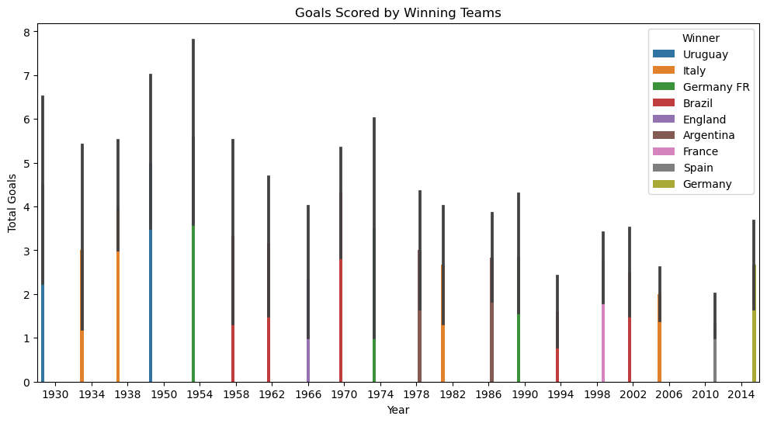
Goals Scored by Winning Teams:

Slide 8
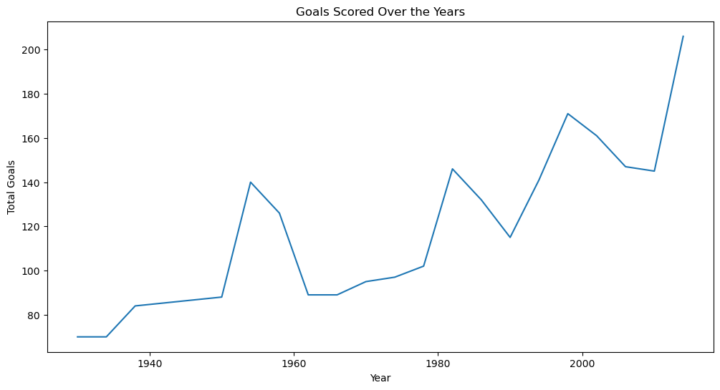
Goals Scored Over the Years:

Slide 9
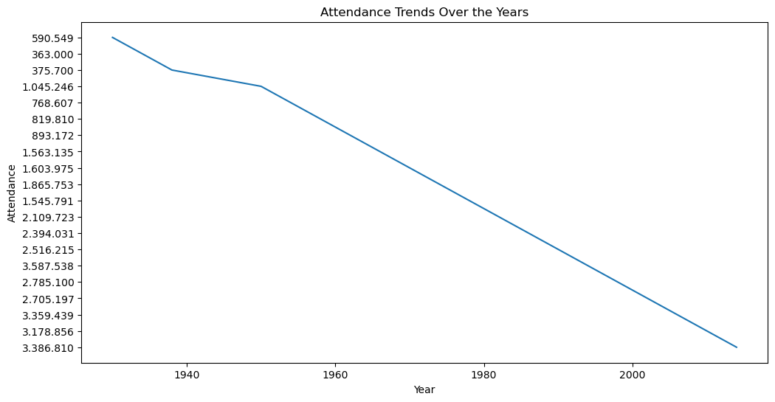
Attendance Trends Over the Years:

Slide 10
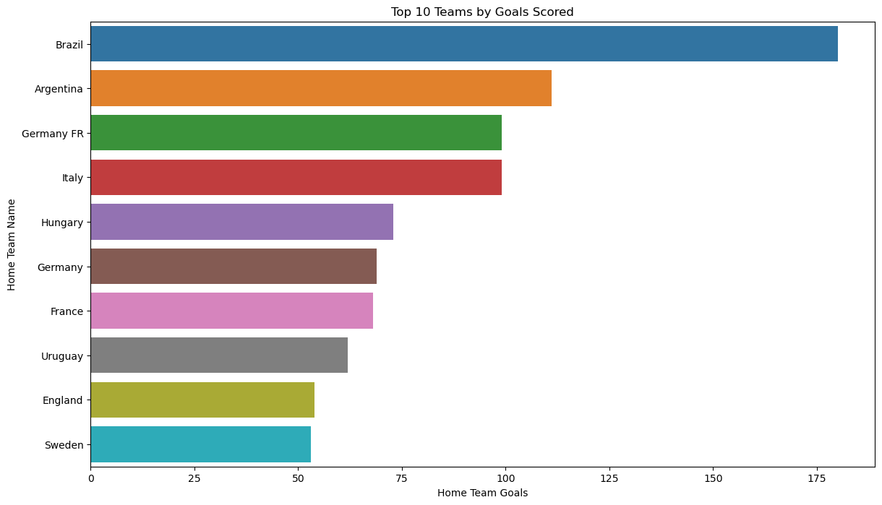
Top 10 Teams by Goals Scored:

Slide 11
THANK YOU

